Slide 1
The Evolution of Bicycling Infrastructure in 3 Canadian Cities from 2010 to 2022
Richard Wen Brice Batomen Linda Rothman
Postdoctoral Fellow Associate Professor Associate Professor
Dalla Lana School of Public Health Dalla Lana School of Public Health School of Occupational and Public Health
University of Toronto University of Toronto Toronto Metropolitan University
rrwen.work@gmail.com brice.kuimi@utoronto.ca linda.rothman@torontomu.ca
Parachute Vision Zero | Webinar | October 1, 2025 |CIHR’s RECOVR Project Part 2

Slide 2
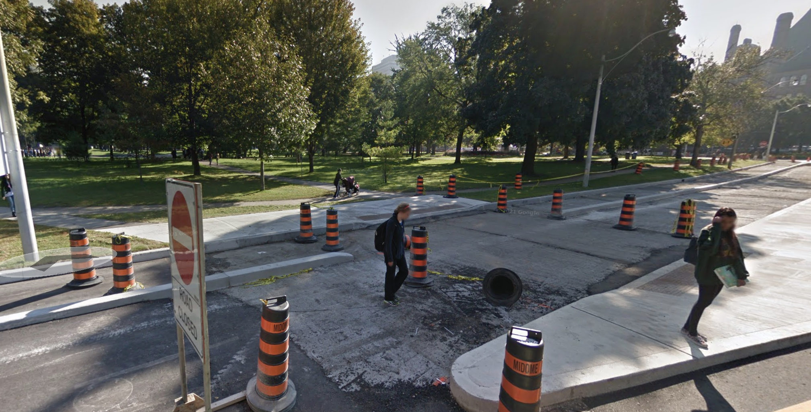
18 Queens Park Crescent West (2014): https://www.google.com/maps/@43.6639598,-79.3934992,3a,75y,90.98h,77.06t/data=!3m8!1e1!3m6!1swp8Jyi26q4b1QU3m0bjReQ!2e0!5s20140901T000000!6shttps:%2F%2Fstreetviewpixels-pa.googleapis.com%2Fv1%2Fthumbnail%3Fcb_client%3Dmaps_sv.tactile%26w%3D900%26h%3D600%26pitch%3D12.939999999999998%26panoid%3Dwp8Jyi26q4b1QU3m0bjReQ%26yaw%3D90.98!7i13312!8i6656?entry=ttu&g_ep=EgoyMDI1MDkyNC4wIKXMDSoASAFQAw%3D%3D

Slide 3
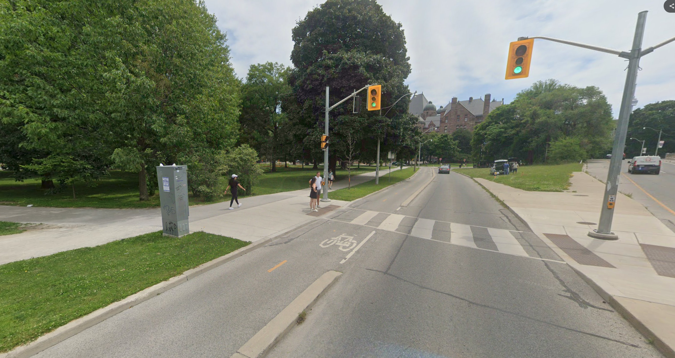
18 Queens Park Crescent West (2024): https://www.google.com/maps/@43.6639861,-79.3934496,3a,75y,117.51h,81.22t/data=!3m8!1e1!3m6!1sYpYs6rbl9H71D6Q25BGiJw!2e0!5s20240701T000000!6shttps:%2F%2Fstreetviewpixels-pa.googleapis.com%2Fv1%2Fthumbnail%3Fcb_client%3Dmaps_sv.tactile%26w%3D900%26h%3D600%26pitch%3D8.779644416788557%26panoid%3DYpYs6rbl9H71D6Q25BGiJw%26yaw%3D117.51208002983246!7i16384!8i8192?entry=ttu&g_ep=EgoyMDI1MDkyNC4wIKXMDSoASAFQAw%3D%3D

Slide 4
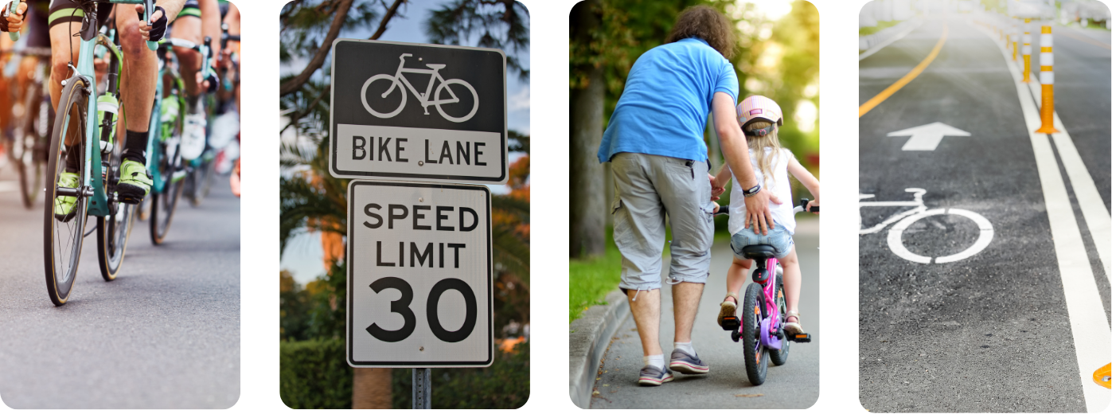
The Pandemic Cycling Boom and Safer Streets
More Cyclists
11 of 13 Countries²
(e.g. +27% Italy²)
Reduced Speed Limits
30 km/h
(e.g. Slow streets Vancouver³)
Cycling Education
Free Courses
(e.g. 6/7th grade schools Vancouver⁴)
More Infrastructure
Network Expansions
(e.g. 17 routes by 2027 Montréal⁵)
²Buehler, R., & Pucher, J. (2022). Cycling through the COVID-19 pandemic to a more sustainable transport future: Evidence from case studies of 14 large bicycle-friendly cities in Europe and North America. Sustainability, 14(12), 7293.
³https://vancouver.ca/streets-transportation/making-streets-for-people-program. ⁴https://bikehub.ca/bike-to-school
⁵https://montreal.ca/en/articles/ebn-montreals-express-bike-network-4666

Slide 5
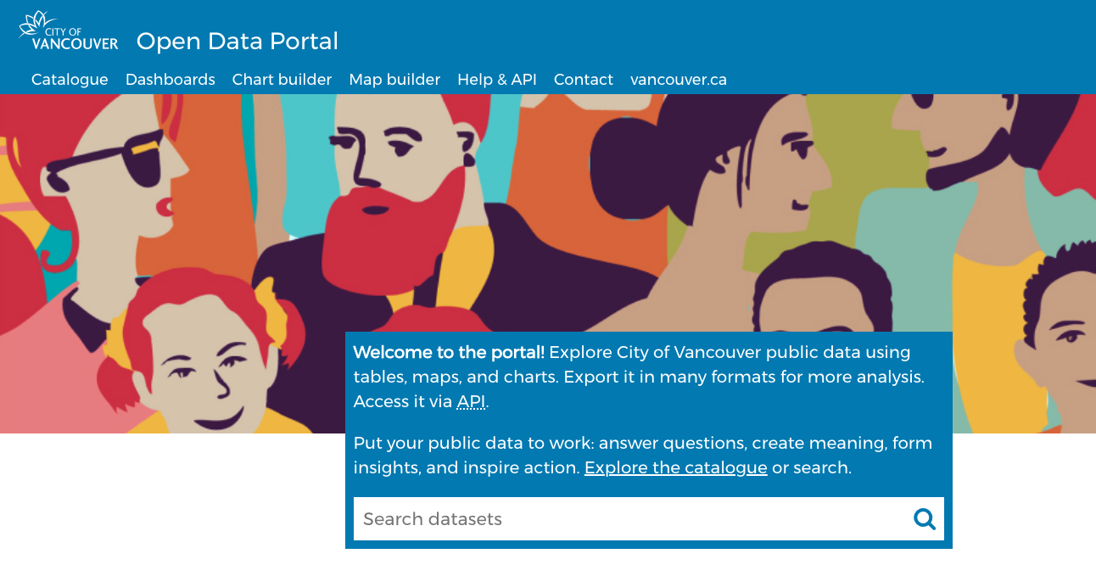


Are Our Cities Evolving? How Do We Know?
Accuracy?
Consistency?
⁶
Updates?
⁷
⁸
⁶https://opendata.vancouver.ca ⁷https://data.calgary.ca ⁸https://open.toronto.ca

Slide 6

Research Objectives
For dedicated cycling infrastructure (painted lanes, buffered lanes, and cycle tracks as defined by the Canadian Bikeway Comfort and Safety (Can-BICS)⁹ classification system) in the cities of Vancouver, Calgary, and Toronto from 2010 to 2022:
(1) Verify that city installation and upgrade data are accurate
(2) Evaluate yearly trends in cycling infrastructure across cities
⁹Winters, M., Zanotto, M., & Butler, G. (2020). At-a-glance-The Canadian Bikeway Comfort and Safety (Can-BICS) Classification System: a common naming convention for cycling infrastructure. Health promotion and chronic disease prevention in Canada: research, policy and practice, 40(9), 288.

Slide 7
Data: Painted and Protected Bikeways
Vancouver Bikeways
opendata.vancouver.ca
3666 ➜ 3118 Included Road Segments
Local Street bikeways, protected bike lanes, painted lanes, shared lanes
Included: On-street painted lanes, protected bike lanes, local street bikeways
Calgary Bikeways
data.calgary.ca
4169 ➜ 752 Included Road Segments
Cycle tracks, bike lanes, on-street bikeways, shared lanes, temporary and decommissioned routes
Included: Active bike lanes, cycle tracks
Toronto Bikeways
open.toronto.ca
1323 ➜ 326 Included Road Segments
Cycle tracks, bike lanes, neighborhood routes with sharrows, multi-use trails, signed cycling routes
Included: Cycle tracks, bike lanes

Slide 8



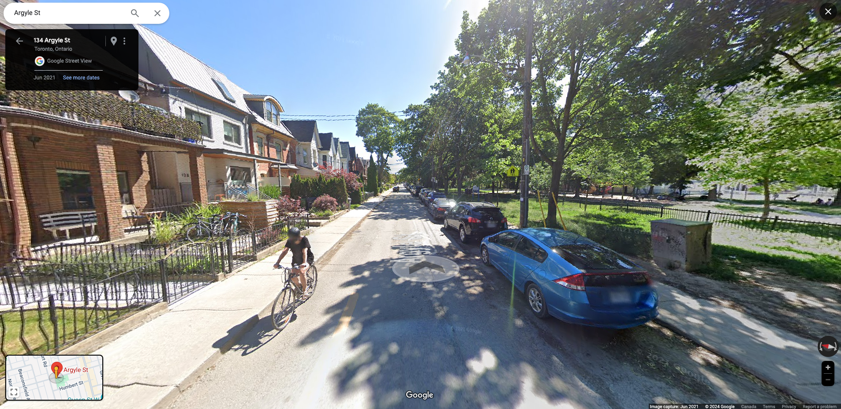
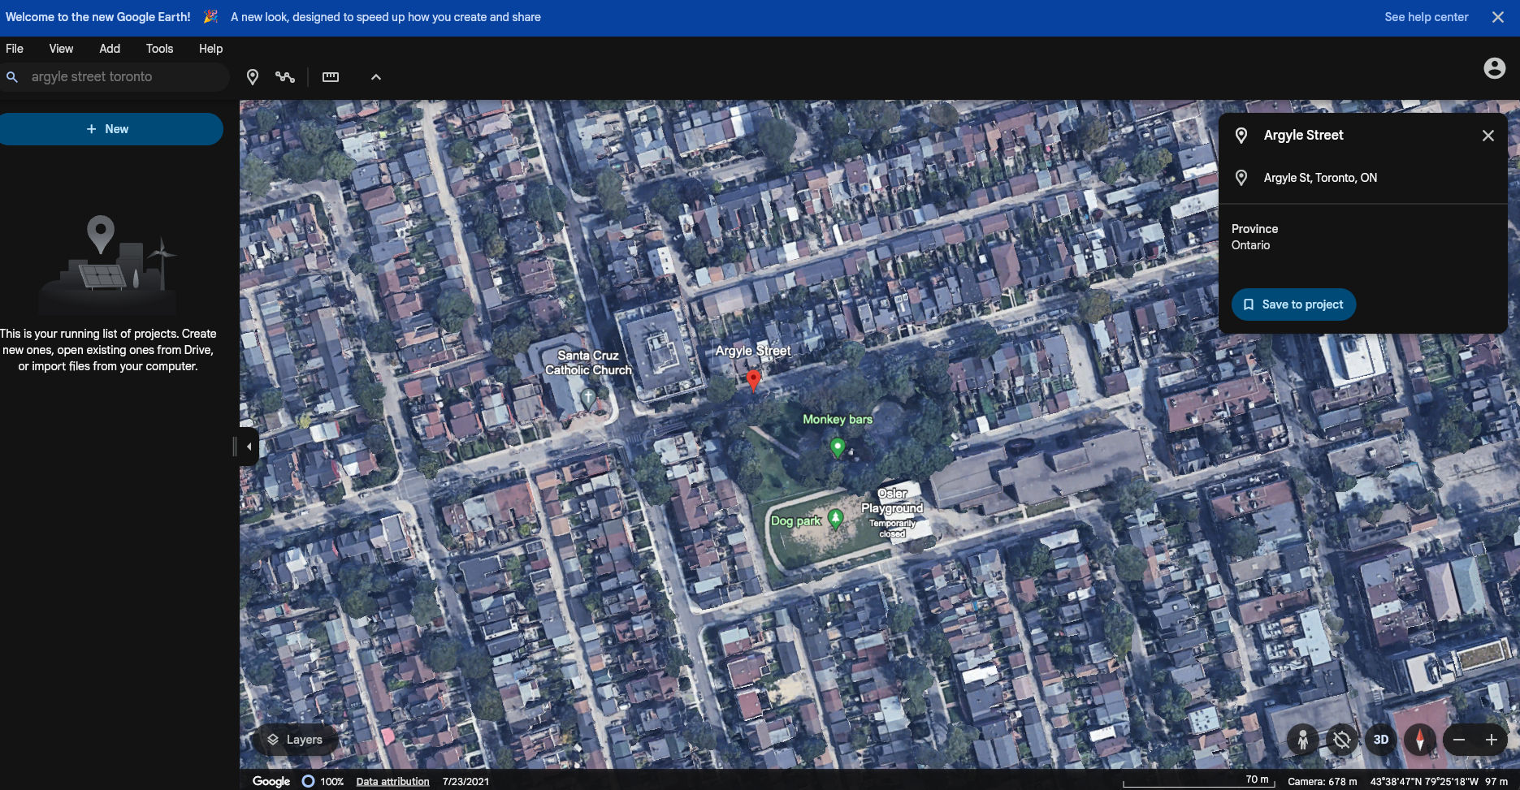

Methods: (1) Verification

Slide 9


Methods: (2) Evaluation
Plot infrastructure road lengths for each year and city
Changes Over Time
Map infrastructure installations and upgrades for each city
Changes Over Space

Slide 10
Results: Installation Year Accuracy, Vancouver
83.3% Correct
97.2% ±1 Year
0 = Correct

Slide 11
Results: Installation Year Accuracy, Calgary
42.1% Correct
62.7% ±1 Year
0 = Correct

Slide 12
Results: Installation Year Accuracy, Toronto
74.5% Correct
78.2% ±1 Year
0 = Correct

Slide 13
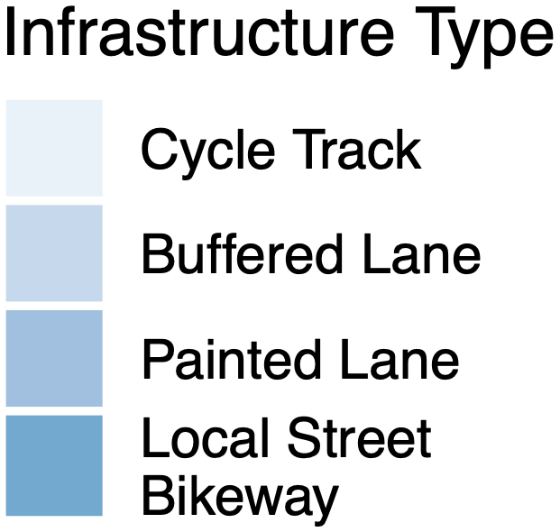
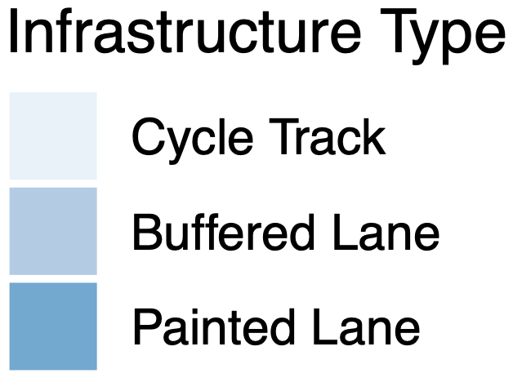
Results: Infrastructure per 1000 km of Roadway

Slide 14
Results: Net Change per 1000 km of Roadway

Slide 15
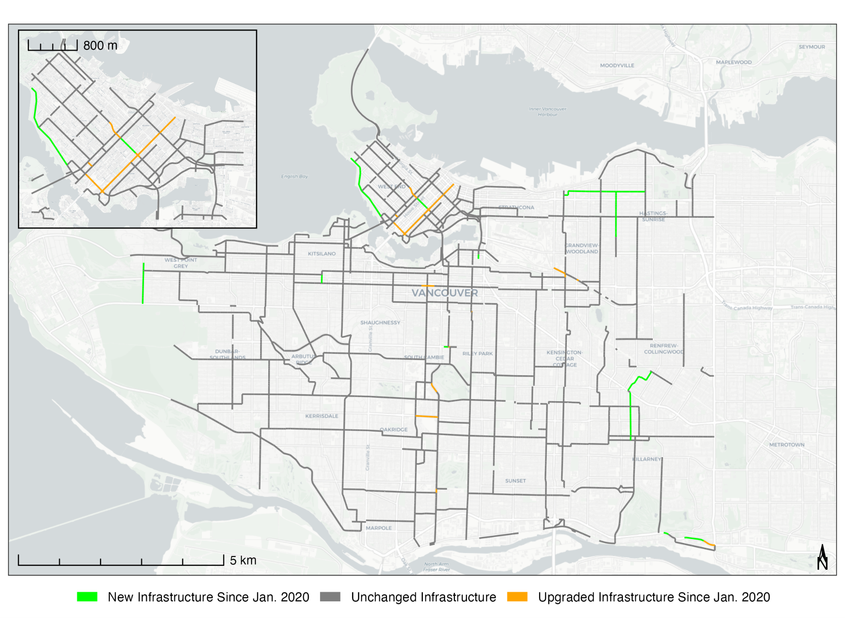
Results: Changes Since January 2020, Vancouver

Slide 16
Results: Changes Since January 2020, Calgary

Slide 17
Results: Changes Since January 2020, Toronto

Slide 18



Conclusion
Cycling infrastructure growth since 2009 especially after 2019.
Evidence of infrastructure change to guide policy and decisions.
~42/74/83% of Calgary/Toronto/Vancouver city data had correct install years.
Need to improve data verification & standards for research purposes.
Trends comparable across cities with standardized infrastructure types. However, care needed to standardize infrastructure types for study purposes.

Slide 19

Acknowledgements
This study was supported by the Canadian Institutes of Health Research (CIHR).

Slide 20


Thank You for Your Time! Richard Wen Postdoctoral Fellow rrwen.work@gmail.com R Code and Data for Figures and Tables
https://rrwen.github.io/recovr-infracycle

